Slide 1
UNIVERSITY INSTITUTE OF COMPUTING
MASTER OF COMPUTER APPLICATIONS
DESIGN AND ANALYSIS OF ALGORITHMS
UNIT-2
DISCOVER . LEARN . EMPOWER

Slide 2
Topics to be covered
Dijkstra’s Algorithm
Huffman Trees and Codes
Heaps and Hear Sort

Slide 3
Introduction
Dijkstra Algorithm is a very famous greedy algorithm.
It is used for solving the single source shortest path problem.
It computes the shortest path from one particular source node to all other remaining nodes of the graph.

Slide 4
Shortest Path Problem
In data structures,
Shortest path problem is a problem of finding the shortest path(s) between vertices of a given graph.
Shortest path between two vertices is a path that has the least cost as compared to all other existing paths.
Shortest Path Algorithms-
Shortest path algorithms are a family of algorithms used for solving the shortest path problem.
Google Maps
Road Networks
Logistics Research

Slide 5
Shortest Path Problem
Types of Shortest Path Problem-
Single-Pair Shortest Path Problem
It is a shortest path problem where the shortest path between a given pair of vertices is computed.
A* Search Algorithm is a famous algorithm used for solving single-pair shortest path problem.
Single-Source Shortest Path Problem-
It is a shortest path problem where the shortest path from a given source vertex to all other remaining vertices is computed.
Dijkstra’s Algorithm and Bellman Ford Algorithm are the famous algorithms used for solving single-source shortest path problem.

Slide 6
Shortest Path Problem
Single-Destination Shortest Path Problem-
It is a shortest path problem where the shortest path from all the vertices to a single destination vertex is computed.
By reversing the direction of each edge in the graph, this problem reduces to single-source shortest path problem.
Dijkstra’s Algorithm is a famous algorithm adapted for solving single-destination shortest path problem.
All Pairs Shortest Path Problem-
It is a shortest path problem where the shortest path between every pair of vertices is computed.
Floyd-Warshall Algorithm and Johnson’s Algorithm are the famous algorithms used for solving All pairs shortest path problem.

Slide 7
Dijkstra's Algorithm
Dijkstra Algorithm is a very famous greedy algorithm.
It is used for solving the single source shortest path problem.
It computes the shortest path from one particular source node to all other remaining nodes of the graph.
It is important to note the following points regarding Dijkstra Algorithm-
Dijkstra algorithm works only for connected graphs.
Dijkstra algorithm works only for those graphs that do not contain any negative weight edge.
It provides the value or cost of the shortest paths.
By making minor modifications in the actual algorithm, the shortest paths can be easily obtained.
Dijkstra algorithm works for directed as well as undirected graphs.

Slide 8
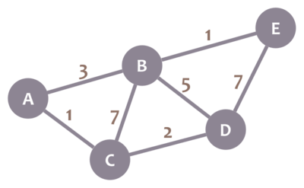
Dijkstra's Algorithm
Dijkstra's Algorithm allows you to calculate the shortest path between one node (you pick which one) and every other node in the graph.
Calculate the shortest path between node C and the other nodes in our graph:

Slide 9
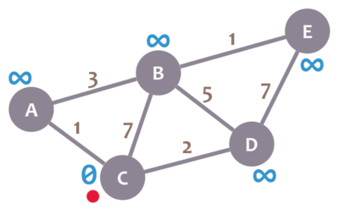
Steps

Slide 10
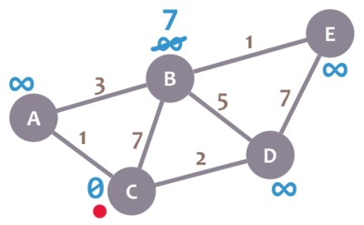
Next Step
We'll also have a current node. Initially, we set it to C (our selected node). In the image, we mark the current node with a red dot.
Now, we check the neighbours of our current node (A, B and D) in no specific order. Let's begin with B. We add the minimum distance of the current node (in this case, 0) with the weight of the edge that connects our current node with B (in this case, 7), and we obtain 0 + 7 = 7. We compare that value with the minimum distance of B (infinity); the lowest value is the one that remains as the minimum distance of B (in this case, 7 is less than infinity):

Slide 11
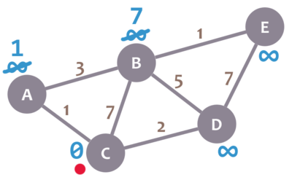
Next Step
Now, let's check neighbour A. We add 0 (the minimum distance of C, our current node) with 1 (the weight of the edge connecting our current node with A) to obtain 1. We compare that 1 with the minimum distance of A (infinity), and leave the smallest value:

Slide 12
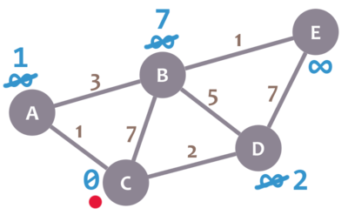
Next Step
Repeat the same procedure for D:

Slide 13
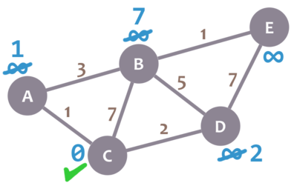
Next Step
We have checked all the neighbours of C. Because of that, we mark it as visited. Let's represent visited nodes with a green check mark:

Slide 14
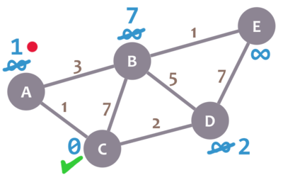
Next Step
We now need to pick a new current node. That node must be the unvisited node with the smallest minimum distance (so, the node with the smallest number and no check mark). That's A. Let's mark it with the red dot:

Slide 15
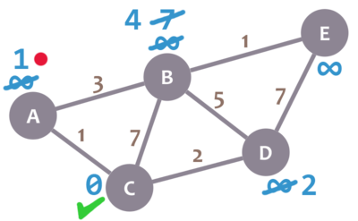
Next Step
And now we repeat the algorithm. We check the neighbours of our current node, ignoring the visited nodes. This means we only check B.
For B, we add 1 (the minimum distance of A, our current node) with 3 (the weight of the edge connecting A and B) to obtain 4. We compare that 4 with the minimum distance of B (7) and leave the smallest value: 4.

Slide 16
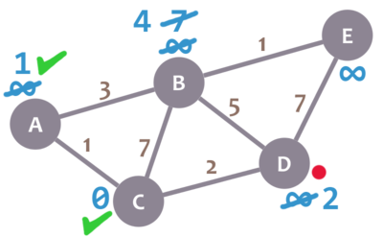
Next Step
Afterwards, we mark A as visited and pick a new current node: D, which is the non-visited node with the smallest current distance.

Slide 17
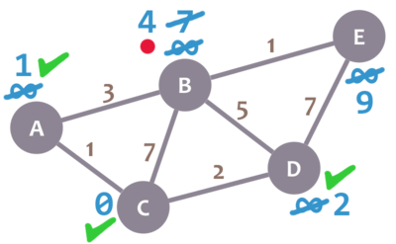
Next Step
We repeat the algorithm again. This time, we check B and E.
For B, we obtain 2 + 5 = 7. We compare that value with B's minimum distance (4) and leave the smallest value (4). For E, we obtain 2 + 7 = 9, compare it with the minimum distance of E (infinity) and leave the smallest one (9).
We mark D as visited and set our current node to B.

Slide 18
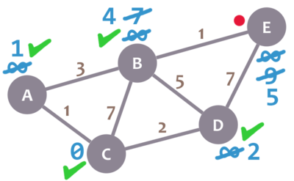
Next Step
Almost there. We only need to check E. 4 + 1 = 5, which is less than E's minimum distance (9), so we leave the 5. Then, we mark B as visited and set E as the current node.

Slide 19
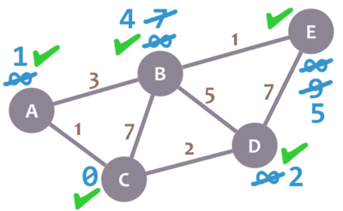
Next Step
E doesn't have any non-visited neighbours, so we don't need to check anything. We mark it as visited.

Slide 20
Next Step
As there are not unvisited nodes, we're done! The minimum distance of each node now actually represents the minimum distance from that node to node C (the node we picked as our initial node)!

Slide 21
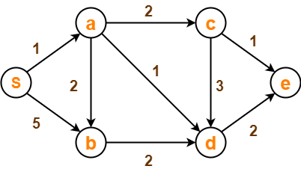
Example
Using Dijkstra’s Algorithm, find the shortest distance from source vertex ‘S’ to remaining vertices in the following graph-

Slide 22
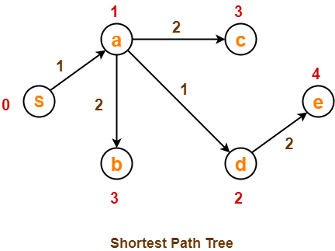
Example
The order in which all the vertices are processed is :
S , a , d , b , c , e

Slide 23
Prefix Codes
Let there be four characters a, b, c and d, and their corresponding variable length codes be 00, 01, 0 and 1.
This coding leads to ambiguity because code assigned to c is the prefix of codes assigned to a and b.
If the compressed bit stream is 0001, the de-compressed output may be “cccd” or “ccb” or “acd” or “ab”.

Slide 24
Huffman Coding
Huffman Coding is a famous Greedy Algorithm.
It is used for the lossless compression of data.
It uses variable length encoding.
It assigns variable length code to all the characters.
The code length of a character depends on how frequently it occurs in the given text.
The character which occurs most frequently gets the smallest code.
The character which occurs least frequently gets the largest code.
Huffman Coding implements a rule known as a prefix rule.
This is to prevent the ambiguities while decoding.
It ensures that the code assigned to any character is not a prefix of the code assigned to any other character.
It is also known as Huffman Encoding.

Slide 25
Huffman Coding
Huffman Coding is a technique of compressing data to reduce its size without losing any of the details. It was first developed by David Huffman.
Huffman Coding is generally useful to compress the data in which there are frequently occurring characters.
Huffman coding assigns codes to characters such that the length of the code depends on the relative frequency or weight of the corresponding character. Huffman codes are of variable-length, and prefix-free (no code is prefix of any other). Any prefix-free binary code can be visualized as a binary tree with the encoded characters stored at the leaves.

Slide 26
Huffman coding tree
Huffman coding tree or Huffman tree is a full binary tree in which each leaf of the tree corresponds to a letter in the given word.
One can often gain an improvement in space requirements in exchange for a penalty in running time. There are many situations where this is a desirable tradeoff. A typical example is storing files on disk. If the files are not actively used, the owner might wish to compress them to save space. Later, they can be uncompressed for use, which costs some time, but only once.
We often represent a set of items in a computer program by assigning a unique code to each item. For example, the standard ASCII coding scheme assigns a unique eight-bit value to each character. It takes a certain minimum number of bits to provide enough unique codes so that we have a different one for each character.

Slide 27
Huffman Coding
Huffman Codes
(i) Data can be encoded efficiently using Huffman Codes.
(ii) It is a widely used and beneficial technique for compressing data.
(iii) Huffman's greedy algorithm uses a table of the frequencies of occurrences of each character to build up an optimal way of representing each character as a binary string.
Suppose we have 10⁵ characters in a data file. Normal Storage: 8 bits per character (ASCII) - 8 x 10⁵ bits in a file. But we want to compress the file and save it compactly. Suppose only six characters appear in the file:

Slide 28
Huffman coding
(i) Fixed length Code: Each letter represented by an equal number of bits. With a fixed length code, at least 3 bits per character:
a 000
b 001
c 010
d 011
e 100
f 101
For a file with 10⁵ characters, we need 3 x 10⁵ bits.
(ii) A variable-length code: It can do considerably better than a fixed-length code, by giving many characters short code words and infrequent character long codewords.
a 0
b 101
c 100
d 111
e 1101
f 1100
Number of bits = (45 x 1 + 13 x 3 + 12 x 3 + 16 x 3 + 9 x 4 + 5 x 4) x 1000
= 2.24 x 10⁵bits

Slide 29

How Huffman Coding works?
Suppose the string below is to be sent over a network.
Fig 1: Initial string

Slide 30
How Huffman Coding works?
Each character occupies 8 bits. There are a total of 15 characters in the above string. Thus, a total of 8 * 15 = 120 bits are required to send this string.
Using the Huffman Coding technique, we can compress the string to a smaller size.
Huffman coding first creates a tree using the frequencies of the character and then generates code for each character.

Slide 31
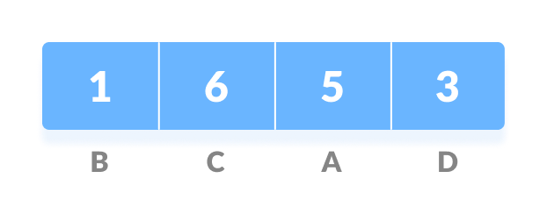
How Huffman Coding works?
Huffman coding is done with the help of the following steps.
1. Calculate the frequency of each character in the string.
Fig 2: Frequency of string

Slide 32
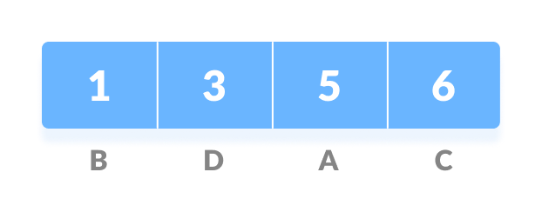
How Huffman Coding works?
2. Sort the characters in increasing order of the frequency. These are stored in a priority queue Q.
Fig 3: Characters sorted according to the frequency

Slide 33
How Huffman Coding works?
3. Make each unique character as a leaf node.
4. Create an empty node z. Assign the minimum frequency to the left child of z and assign the second minimum frequency to the right child of z. Set the value of the z as the sum of the above two minimum frequencies.

Slide 34
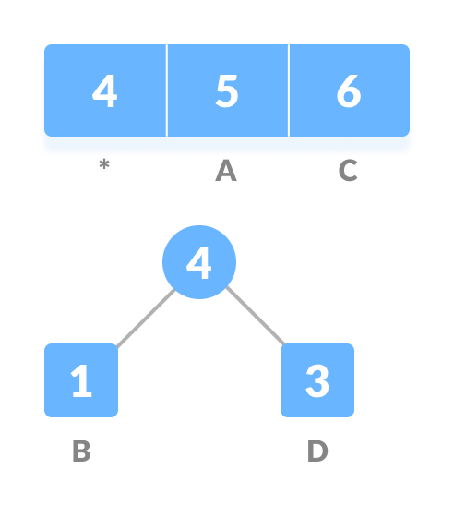
How Huffman Coding works?
Fig 4: Getting the sum of the least numbers

Slide 35
Contd…
5. Remove these two minimum frequencies from Q and add the sum into the list of frequencies (* denote the internal nodes in the figure above).
6. Insert node z into the tree.
7. Repeat steps 3 to 5 for all the characters.

Slide 36
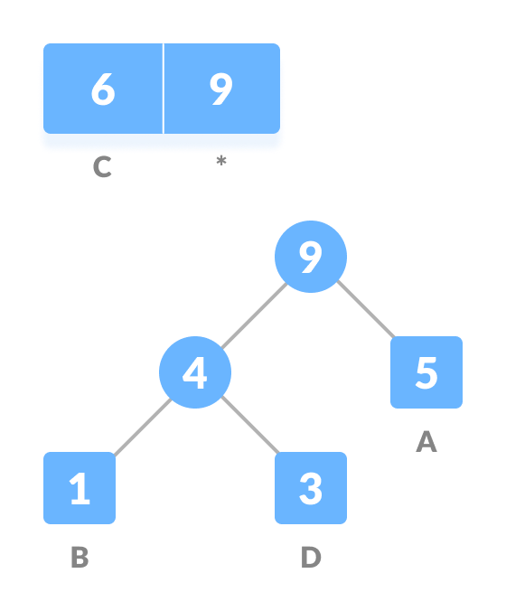
Contd…
Fig 5: Repeat steps 3 to 5 for all the characters.

Slide 37
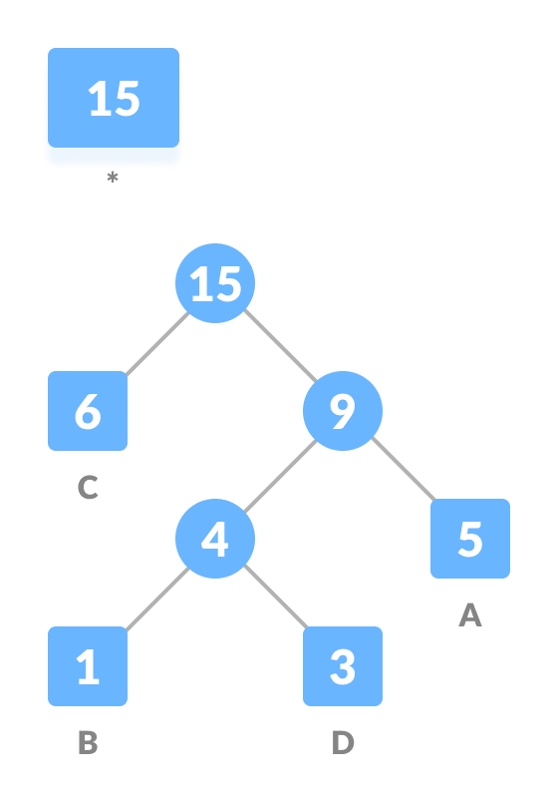
Contd…
Fig 6: Repeat steps 3 to 5 for all the characters.

Slide 38
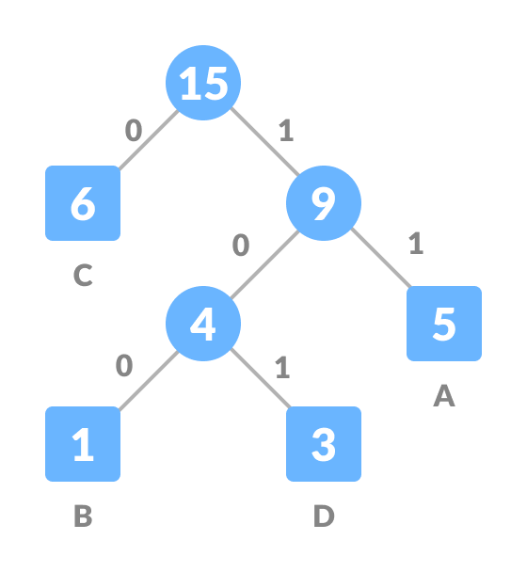
Contd…
8. For each non-leaf node, assign 0 to the left edge and 1 to the right edge.
Fig 7: Assign 0 to the left edge and 1 to the right edge

Slide 39
Contd…
For sending the above string over a network, we have to send the tree as well as the above compressed-code. The total size is given by the table below.
Character | Frequency | Code | Size
A | 5 | 11 | 5*2 = 10
B | 1 | 100 | 1*3 = 3
C | 6 | 0 | 6*1 = 6
D | 3 | 101 | 3*3 = 9
4 * 8 = 32 bits |  | 9 Bits | 28 bits

Slide 40
Contd…
Without encoding, the total size of the string was 120 bits. After encoding the size is reduced to 32 + 9 + 28 = 69 bits

Slide 41

Decoding the code
For decoding the code, we can take the code and traverse through the tree to find the character.
Let 101 is to be decoded, we can traverse from the root as in the figure below.

Slide 42
2. Example
Letter freqency table
Letter frequency table
Letter | Z | K | M | C | U | D | L | E
Frequency | 2 | 7 | 24 | 32 | 37 | 42 | 42 | 120

Slide 43
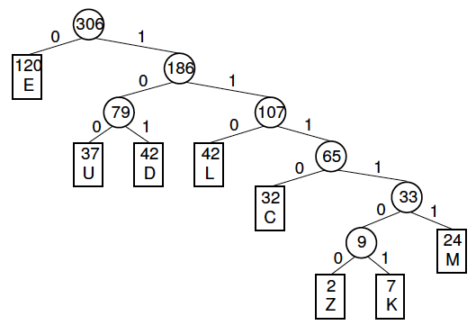
The Huffman tree

Slide 44
Contd..
Huffman code
Letter | Freq | Code | Bits
E | 120 | 0 | 1
D | 42 | 101 | 3
L | 42 | 110 | 3
U | 37 | 100 | 3
C | 32 | 1110 | 4
M | 24 | 11111 | 5
K | 7 | 111101 | 6
Z | 2 | 111100 | 6

Slide 45
Contd..
Three problems:
Problem 1: Huffman tree building
Problem 2: Encoding
Problem 3: Decoding
Problem 2: Encoding
Encoding a string can be done by replacing each letter in the string with its binary code (the Huffman code).
Examples:
DEED 10100101 (8 bits)
MUCK 111111001110111101 (18 bits)
Problem 3: Decoding
Decoding an encoded string can be done by looking at the bits in the coded string from left to right until a letter decoded.
10100101 -> DEED

Slide 46
References
https://www.codingame.com/playgrounds/1608/shortest-paths-with-dijkstras-algorithm/dijkstras-algorithm
Books:
Introduction to Algorithms by Coreman, Leiserson, Rivest, Stein.
Fundamentals of Algorithms by Ellis Horwitz, Sartaj Sahni, Sanguthevar Rajasekaran

Slide 47
THANK YOU
For query: gurpreetkaur.uic@cumail.in

